Slide 1
DMV Automation in Java
By Nicholas Foley
COSC-1437
Professor Pete Ortega

Slide 2
What is the problem?
Nobody likes waiting in line all day at the DMV and sometimes making an appointment gets put off or forgotten. The idea is simple, automate the renewal and replacement of IDs and licenses to a machine (kiosk) so the DMV employees can service the people who need a person to help them, and the machines can take the tedious work. I think that this is important because it should be fast and easy to get a new license or ID, and we should not have to sit around for sometimes hours to get something that everyone needs on a daily basis.

Slide 3
Pseudocode
class main
take inputs : (name, DOB, idNumber, issueDate, expirationDate)
call person object
outputs new values
class person
person object : takes(name, DOB, idNumber, issueDate, expirationDate)
number generation methods: takes(idNumber, issueDate, expirationDate) to generate new values

Slide 4

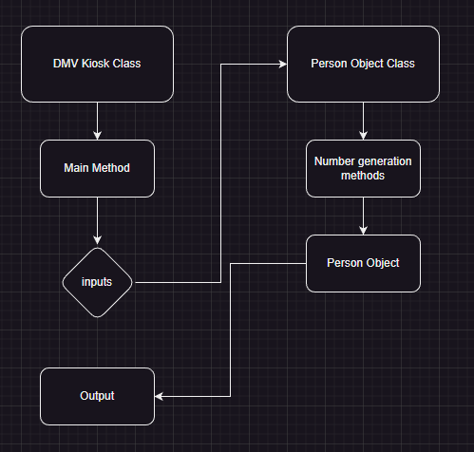
Diagram
The program takes the user input
Passes that input into the person object class
New values are generated
Values are updated in person object
Values are outputted

